Slide 1

SECD2523 DATABASE
Structured Query Language (SQL) 1|
Data Definition Language (DDL)
Content adapted from Connolly, T., Begg, C., 2015. Database Systems: A Practical Approach to Design, Implementation, and Management, Global Edition. Pearson Education.

Slide 2
LECTURE LEARNING OUTCOME
By the end of this lecture, students should be able to:
01
Perform basic operations in a DBMS software
02
Construct SQL statements to:
Create and delete tables
  Perform changes to table structure
  Include integrity constraints to tables

Slide 3
01
Introduction to DBMS & DDL
02
Data Integrity Constraints
03
CREATE TABLE
04
ALTER TABLE
05
DROP TABLE
06
Other Useful Statements

Slide 4
Introduction to DBMS
DBMS:
  A software system that enables users to define, create, and maintain the database and that provides controlled access to this database.
  DBMS perform the tasks through commands (aka queries) written in Structured Query Language (SQL)
  Example of DBMS
    mySQL (what we will be using for this course)
    Oracle

Slide 5
Structured Query Language
A database language that allows users to:
Create database and relation structures.
Perform basic data management tasks (insertion, modification and deletion of data from relations)
Perform simple and complex queries.
Two major components:
Data Definition Language (DDL)
Data Manipulation Language (DML)
5

Slide 6
Data Definition Language (DDL)
Definition:
  A language that allows DBA or user to describe and name the entities, attributes, and relationships required for the application, together with any associated integrity and security constraints.
DDL allows database objects (schemas, domains, tables, views, etc) to be created, modified or deleted. Examples of DDL statements:
  CREATE SCHEMA … DROP SCHEMA …
  CREATE TABLE … DROP TABLE …
  ALTER TABLE …

Slide 7
Integrity Enhancement Feature
SQL provides some facilities for integrity control to protect the database from becoming inconsistent.
  Required Data
    Using the NOT NULL constraint for column to ensure the column must contain a valid value.
  Entity Integrity
    Using PRIMARY KEY constraint for a column with unique, non-null value. Only ONE primary key per table.
    Use UNIQUE constraint for column with unique values. Allow to be NULL but can assign to multiple columns.
  Referential Integrity
    Using FOREIGN KEY constraint to link to parent table that containing the matching attribute. A table can have multiple foreign keys.

Slide 8
Data Integrity Constraints
Constraints | Description
NOT NULL | The column cannot contain a null value
UNIQUE | The values for a column or a combination of columns must be unique for all rows in the table, allows NULL value
PRIMARY KEY | The column (or a combination of columns) must contain the unique AND IS NOT NULL value for all rows
FOREIGN KEY | The column (or a combination of columns) must establish and enforce a reference to a column or a combination of columns in another (or the same) table
CHECK | A condition must be true when the query is executed

Slide 9
Constraint Guidelines (1)
Name a constraint (otherwise the mySQL server generates one)
Constraints are easier to reference if given a meaningful name (e.g.: emp_deptNo fk or dept_deptNo pk)
Create a constraint at either of the following times:
  At the same time as the creation of the table
  After the creation of the table
Define a constraint at the column or table level
View a constraint in the data dictionary

Slide 10
Constraint Guidelines (2)
Column-level constraints are included when the column is defined
Table-level constraints are defined at the end of the table definition, and must refer to the column or columns on which the constraints pertains
Functionally, a column-level constraint is the same as a table-level constraint
NOT NULL constraints can be defined only at the column level
Constraints that apply to more than one column must be defined at the table level

Slide 11
Dealing with Tables
Define database structure and control access to data
CREATE TABLE:
  to create table.
ALTER TABLE:
  to modify the structure of the existing tables.
DROP TABLE:
  to delete the existing tables.

Slide 12
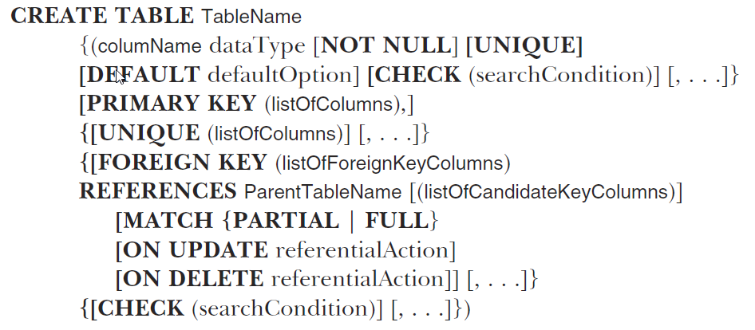
Creating Tables
General SQL syntax for creating a table:
Source: Connolly, 2015
[ ] : optional

Slide 13
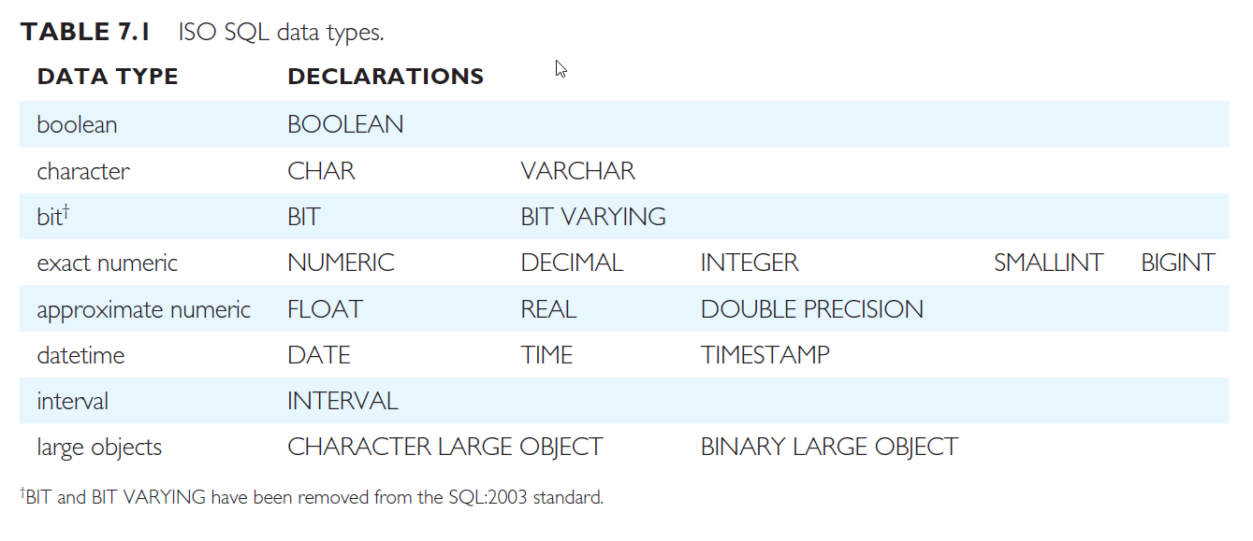
Common SQL Data Type
Overview
Source: Connolly, 2015

Slide 14
Example (CREATE TABLE)
Given the structure of the Department table as follows:
Department
Employees
Attribute | Datatype
deptNo (Primary Key) | Integer (5)
deptName – requires values | Varchar(20)
address | Varchar(30)
city | Varchar(15)
Attribute | Datatype
empID (Primary Key) | Integer
fName – requires values | Varchar(20)
lName – requires values | Varchar(30)
email – unique | Varchar(30)
salary – must be more than 1,700 | Decimal (10,2)
deptNo (Foreign key) – deptNo is an attribute in Department relation | Integer(5)

Slide 15
CREATE TABLE without constraint
Creating a table without constraint.
CREATE TABLE tableName (
columnName dataType [ DEFAULT value ]
[, column2Name datatype [ DEFAULT value]]);
[ ] : optional

Slide 16
Example (CREATE TABLE) without constraint
Create table without constraint:
In this case, constraints (e.g.: Primary Key) can be added using ALTER TABLE command.
CREATE TABLE Department (
deptNo INT(5),
deptName VARCHAR(20),
address VARCHAR(30),
city VARCHAR(15)
);
CREATE TABLE Employees (
empID INT,
fName VARCHAR(10),
lName VARCHAR(20),
deptNo INT(5)
);

Slide 17
CREATE TABLE
(WITH CONSTRAINTS AT COLUMN LEVEL)
Creating a table with constraints.
Constraints at column level.
CREATE TABLE tableName
(columnName dataType [CONSTRAINT constraintName] constraintType [DEFAULT value]
[, column2Name datatype [CONSTRAINT constraintName] constraintType [ DEFAULT value]]);
[ ] : optional

Slide 18
CREATE TABLE
(WITH CONSTRAINTS AT TABLE LEVEL)
Creating a table with constraints.
Constraints at table level.
CREATE TABLE tableName
(columnName dataType [DEFAULT value]
[, column2Name datatype[ DEFAULT value]]
[, CONSTRAINT constraintName constraintType (columnName,…)]);
[ ] : optional

Slide 19
PRIMARY KEY Constraint
A PRIMARY KEY constraint creates a primary key for the table
Only one Primary Key can be created for each table
The PRIMARY KEY constraint is a column or a set of columns that uniquely identifies each row in a table
No column that is part of the primary key can contain a NULL value
A composite primary key must be created at the table level

Slide 20
Example (CREATE TABLE) with constraints
Column-level constraint
CREATE TABLE Department (
deptNo INT(5) CONSTRAINT dept_deptNo_pk PRIMARY KEY,
deptName VARCHAR(20) NOT NULL,
address VARCHAR(30),
city INT(15)
);
Table-level constraint
CREATE TABLE Department (
deptNo INT(5),
deptName VARCHAR(20) NOT NULL,
address VARCHAR(30),
city INT(15),
CONSTRAINT dept_deptNo_pk PRIMARY KEY (dept_No)
);

Slide 21
UNIQUE Constraint
A UNIQUE key integrity constraint requires that every value in a column or a set of columns be unique
If the UNIQUE constraint has more than one column, that group of columns is called a composite unique key
UNIQUE constraints enable the input of NULLs
A NULL in a column (or in all columns of a composite UNIQUE key) always satisfies a UNIQUE constraint

Slide 22
CHECK Constraint
It defines a condition that each row must satisfy
It cannot reference columns from other tables

Slide 23
FOREIGN KEY Constraint
The FOREIGN KEY (or referential integrity) constraint designates a column or a combination of columns as a foreign key
Establishes a relationship with a primary key in the same table or a different table
Here are the guidelines for foreign key constraints:
  A foreign key value must match an existing value in the parent/base table or be NULL
  Foreign keys are based on data values and are purely logical, rather than physical, pointers

Slide 24
FOREIGN KEY Constraint: Keywords
Keyword | Description
FOREIGN KEY | Defines the column in the child table at the table-constraint level
REFERENCES | Identifies the table and column in the parent table
ON DELETE CASCASDE | Deletes the dependent rows in the child table when a row in the parent/base table is deleted
ON DELETE SET NULL | Converts dependent foreign key values to null
Notes:
Without the ON DELETE CASCADE or the ON DELETE SET NULL options, the row in the parent table cannot be deleted if it is referenced in the child table. And these keyword cannot be used in column-level syntax.

Slide 25
Example (CREATE TABLE) with constraints
NOT NULL Constraints
Column-level constraint
CREATE TABLE Employees (
empID INT PRIMARY KEY,
fName VARCHAR(10) NOT NULL,
lName VARCHAR(20) NOT NULL,
email VARCHAR(30) CONSTRAINT emp_email_uk UNIQUE,
salary DECIMAL(10,2) CHECK (salary >= 1700),
deptNo INT(5) CONSTRAINT emp_fk_deptNo FOREIGN KEY (deptNo) REFERENCES Department(deptNo)
);
Table-level constraint
CREATE TABLE Employees (
empID INT,
fName VARCHAR(10) NOT NULL,
lName VARCHAR(20) NOT NULL,
email VARCHAR(30),
deptNo INT(5),
salary DECIMAL(10,2),
CONSTRAINT emp_pk_empID PRIMARY KEY (empID),
CONSTRAINT emp_email_uk UNIQUE (email),
CONSTRAINT emp_chk_salary_min CHECK (salary >= 1700),
CONSTRAINT emp_fk_deptNo FOREIGN KEY (deptNo) REFERENCES Department(deptNo)
);
NOT NULL Constraint can ONLY be defined at the column level

Slide 26
Altering Tables
To change the structure of a table once it has been created.
General Syntax:
ALTER TABLE tableName
ADD columnName dataType );
Add new column
ALTER TABLE tableName
ADD CONSTRAINT constraintName constraintType(columnName);
Add new constraint
ALTER TABLE tableName
MODIFY columnName newdataType/size/defaultvalue;
Change data type, data size, default values, constraints
ALTER TABLE tableName
DROP COLUMN columnName;
Delete column

Slide 27
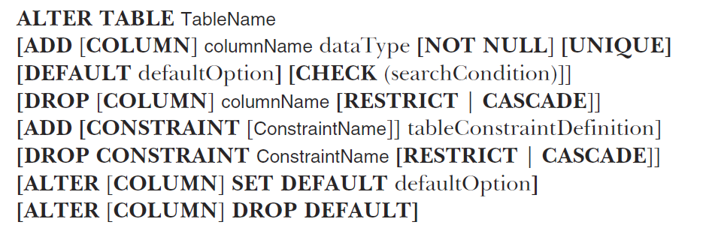
Altering Tables
General syntax for altering tables
Source: Connolly, 2015
[ ] : optional

Slide 28
ALTER TABLE - Examples
Add new column “Address” into Employee table.
Change datatype of “Address” to VARCHAR(20) and set the column as NOT NULL
Delete the column “Address”
ALTER TABLE Employee
ADD Address VARCHAR(40);
ALTER TABLE Employee
MODIFY Address VARCHAR(20) NOT NULL;
ALTER TABLE Employee
DROP COLUMN Address;

Slide 29
ALTER TABLE - Examples
Adding constraint after a table has been created.
Set the attribute of “EmployeeID” as the PRIMARY KEY for the Employee table.
ALTER TABLE Employee
ADD CONSTRAINT emp_pk_EmployeeID
PRIMARY KEY(EmployeeID);
Optional

Slide 30
Example (ALTER TABLE)
If both tables are created without constraint.
Constraints must be added using ALTER TABLE
Department
Employees
Attribute | Datatype
deptNo (Primary Key) | Integer (5)
deptName – requires values | Varchar(20)
address | Varchar(30)
city | Varchar(15)
Attribute | Datatype
empID (Primary Key) | Integer
fName – requires values | Varchar(20)
lName – requires values | Varchar(30)
email – unique | Varchar(30)
salary – must be more than 1,700 | Decimal (10,2)
deptNo (Foreign key) – deptNo is an attribute in Department relation | Integer(5)

Slide 31
Examples (ALTER TABLE)
For Department table, primary key and the NOT NULL constraint for deptName attribute
ALTER TABLE Department
ADD CONSTRAINT pk_Department PRIMARY KEY(deptNo)
MODIFY deptName VARCHAR(20) NOT NULL;
For Employees table, primary key, NOT NULL constraints and foreign key to be added.
ALTER TABLE Employees
MODIFY fName VARCHAR(20) NOT NULL
MODIFY lName VARCHAR(30) NOT NULL
ADD CONSTRAINT pk_Employees PRIMARY KEY(empID)
ADD CONSTRAINT fk_EmpDept FOREIGN KEY (deptNo) REFERENCES Department(deptNo);

Slide 32
Deleting Table
General Syntax:
Example: delete the table named “Employee”
DROP TABLE tableName;
DROP TABLE Employee;

Slide 33
To CREATE a Database
To create a database, use the CREATE DATABASE
To avoid errors if the database already exists, you can use the IF NOT EXISTS clause
CREATE DATABASE database_name;
CREATE DATABASE IF NOT EXISTS database_name;

Slide 34
To Use a specific Database
To use a specific database, use the USE database_name
USE database_name;

Slide 35
To DELETE a Database
To DELETE a database, use the DROP DATABASE database_name
To avoid errors if the database does not exists, you can use the IF EXISTS clause
Important Notes:
  Permanent Deletion: DROP DATABASE is permanent and cannot be undone. Make sure you have backed up any necessary data before running this command
  Use with caution: In a production environment, be especially careful when using a DROP DATABASE to avoid accidental loss
DROP DATABASE database_name;
DROP DATABASE IF EXISTS database_name;

Slide 36
VIEW TABLE STRUCTURE
DESCRIBE
Viewing table structures using DESC or DESCRIBE.
  Syntax:
  Example: View the table structure of Employee table.
Rename a table using RENAME
  Syntax:
  Example: Rename the Employee table to “Workers”
DESCRIBE tableName;
DESCRIBE Employee;
RENAME tableName TO newtableName;
RENAME Employee TO Workers;

Slide 37
CREATE TABLE FROM EXISTING TABLES
(using AS – does not copy constraints)
Create table from existing database tables, using the AS clause and subqueries
Syntax:
Example: create a new table based on the HR Employee table.
CREATE TABLE tableName [(columnName,…)]
AS (…subquery…);
CREATE TABLE NewEmployee
AS (SELECT * FROM hr.Employees);
Subquery

Slide 38
CREATE TABLE FROM EXISTING TABLES
(using LIKE – copy with constraints)
Create table an empty table based on the definition of an existing table.
Includes any column attributes and indexes defined in the original table. Use the LIKE clause Syntax:
Example: create a new table based on the HR Employee table.
CREATE TABLE tableName
LIKE existingTableName;
CREATE TABLE NewEmployee
LIKE hr.Employees;

Slide 39
Exercise
Using mySQL server, do following:
  Create the tables with constraint based on the following information:
Student
CourseReg
Attribute | Datatype | Constraints
studID | Varchar(10) | Primary key
name | Varchar(50) | Requires values
tel | Varchar(15)
nationality | Varchar(30)
Attribute | Datatype | Constraints
studID | Varchar(10) | Combination of both is the primary key
courseID | Varchar(10)
RoomNo | Number with size of 4 | Requires values
NOTE: studID in CourseReg is also a foreign key that refers to Student (studID)

Slide 40
Exercise
  Add a new column called “DOB” with the datatype of DATE to the “Student” table
  Delete column roomNo from “CourseReg” table.
  Add new column called “Availability” that holds variable character data (with the size of 5) to CourseReg table and set the default value to ‘NA’

Slide 41
ANSWER
#1
CREATE TABLE Student (
studID VARCHAR(10) PRIMARY KEY,
name VARCHAR(50) NOT NULL,
tel VARCHAR(15),
nationality VARCHAR(30)
);
CREATE TABLE CourseReg (
studID VARCHAR(10),
courseID VARCHAR(10),
roomNo NUMBER(4) NOT NULL,
CONSTRAINT pk_CourseReg PRIMARY KEY(studID, courseID),
CONSTRAINT fk_courseStud FOREIGN KEY (studID),
REFERENCES Student(studID)
);

Slide 42
ANSWER
#2
ALTER TABLE Student
ADD DOB DATE;
#3
ALTER TABLE CourseReg
DROP COLUMN roomNo;
#4
ALTER TABLE CourseReg
ADD Available VARCHAR(5) DEFAULT ‘NA’;

Slide 43


